Slide 1
Cloud computing fundamental for Azure

Slide 2
Hardware
Computer hardware refers to a system's physical components, including the processor, memory, storage, input/output, and other peripherals. The purpose of computer hardware is to provide a platform for running software applications that allow users to perform various tasks efficiently.
Key: Touch and feel

Slide 3
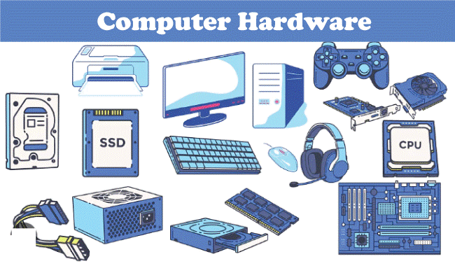
Hardware

Slide 4
Software
A set of instructions that directs a computer’s hardware to perform a task is called a program, or software program.

Slide 5
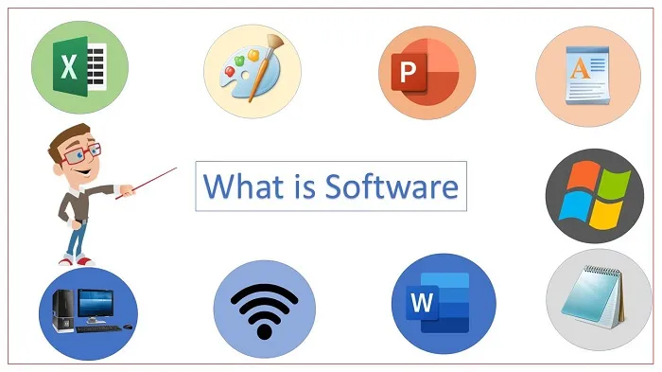
Software

Slide 6
Application
Peace of code that is written for specific purpose

Slide 7

Spring pet clinic
Application that is designed for taking care of pets and plants.

Slide 8
E-learning portal
An eLearning portal is a website that offers learners interaction and collaboration on eLearning content like courses, presentations, podcasts and tests as well as content management for eLearning providers.

Slide 9


Slide 10
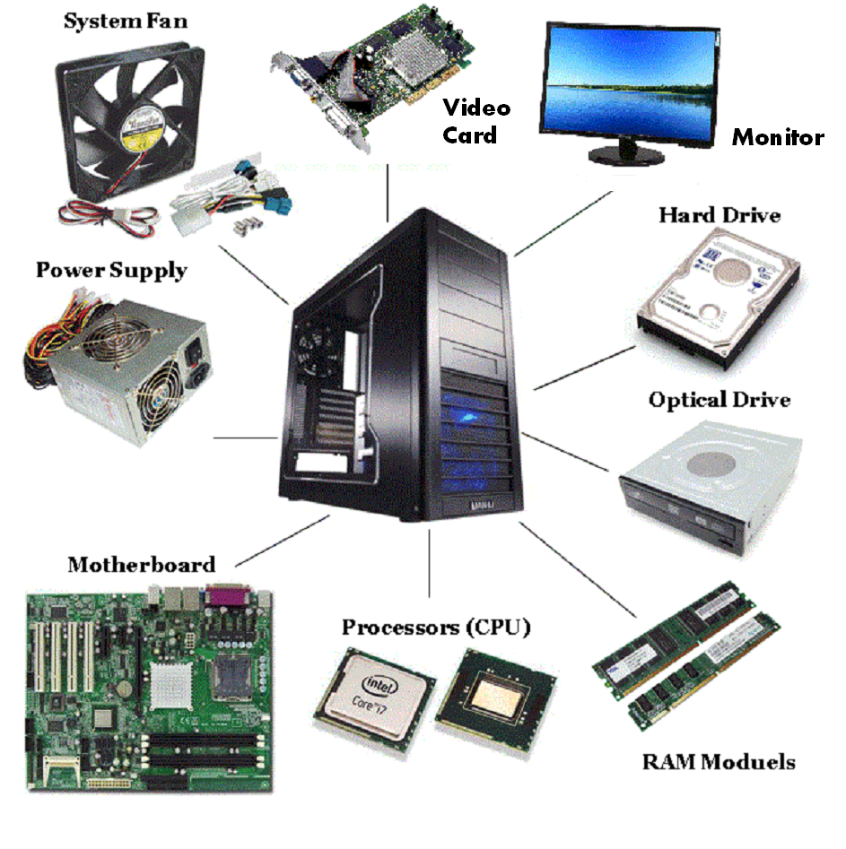
Deep Drive into Hardware

Slide 11
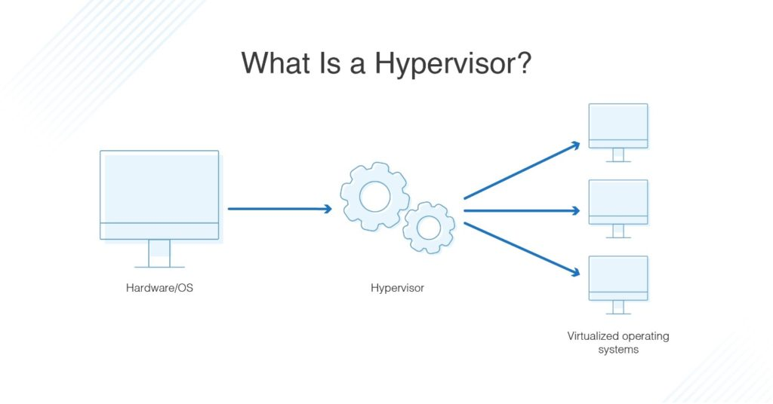
Hypervisor

